Slide 1
Data analysis and visualization (CS306) lab

Slide 2
Lab 2
For all the experiments, you will need to submit a pdf file that should include
all plots/images/figures
the analysis as part of your answer to questions
your code/script
All plots/figures should be labeled properly (x-axis, y-axis, title etc.)
You can use Matlab/Python for programming

Slide 3
Lab 2
Objectives:
To use histograms and box plots as preliminary analysis tools for comparing two or more samples/populations

Slide 4
Lab 2
In this experiment, we will compare two methodologies that are widely used in subjective assessment of video quality. The first method is absolute category rating (ACR) in which the human observer is instructed to rate the quality of displayed video using adjectives: from ‘Bad’ (equivalent numerical score is 1) to ‘Excellent’ (equivalent numerical score 5). The second method is called Subjective Assessment Methodology for Video Quality (SAMVIQ) in which a continuous scale is used: 0 implies bad quality while 100 means excellent quality.

Slide 5
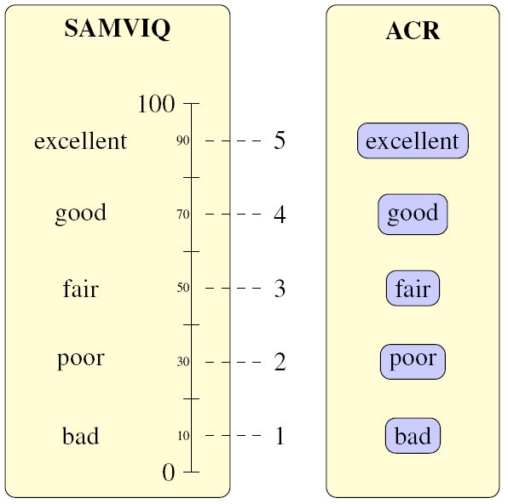
Lab 2
ACR: between 1 and 5 (discrete)
SAMVIQ: between 0 and 100 (continuous)
Philip Corriveau, Christina Gojmerac, Bronwen Hughes, and Lew Stelmach, “All subjective scales are not created equal: the effects of context on different scales,” Signal Processing, vol. 77, no. 1, pp. 1–9, 1999.

Slide 6
Lab 2
Load data_lab2.mat. ‘ACR’ and ‘SAMVIQ’ are the averaged subjective quality scores from 28 and 39 observers respectively. A total of 192 videos were rated.
Compare the quality scores from ACR and SAMVIQ methodologies by creating box plots (do not use the boxplot command but instead create your own function). Which of the two exhibits higher variability around the median? Justify your answer (hint: think of the qualitative differences between the two methods, and also the fact that different number of observers were used for each method)

Slide 7
Lab 2
Which of the two, ACR or SAMVIQ, leads to mathematical outliers (assume points beyond Q₃ + w*IQR or Q₁ - w*IQR with w = 1.5, as mathematical outliers)? Any reason(s)?
Plot the histograms for the two cases (label the axes clearly). Describe the skewness of the two histograms. Can we comment on skewness without plotting the histogram?
Randomly sample half (i.e. 96) the scores for each methodology, and compute the mean in each case. How does it compare with the mean from the original data? Based on this, can we use only 96 samples (instead of 192) to compare ACR and SAMVIQ?

Slide 8
Lab 2
Submit a single pdf file (per group) on Moodle
Deadline: 17/01/2017 (midnight)

